Slide 1
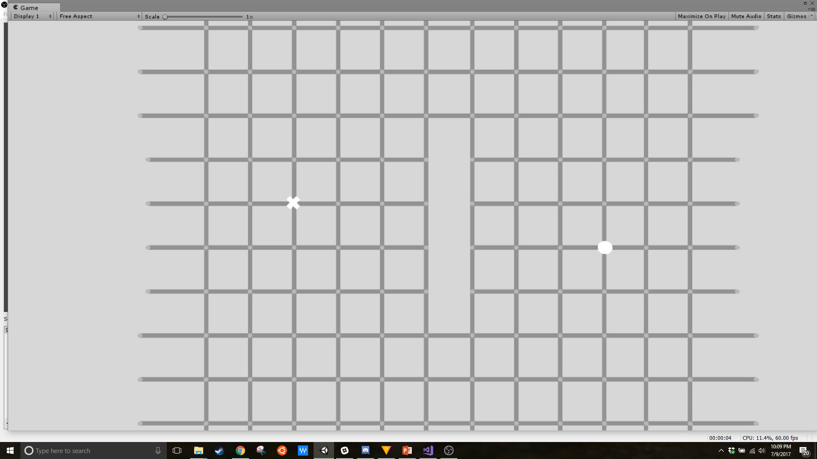
An Introduction to Common Graph Search Algorithms
David McCoy

Slide 2
Breadth Based Search - Flood Fill
Generates a frontier of connected nodes from an adjacency graph
Explores equally in all directions
Useful for finding path to every node within a graph
Returns shortest path by number of nodes traversed
Ignores movement costs and distance to goal node
More specialized algorithms can be implemented quickly from this base

Slide 3
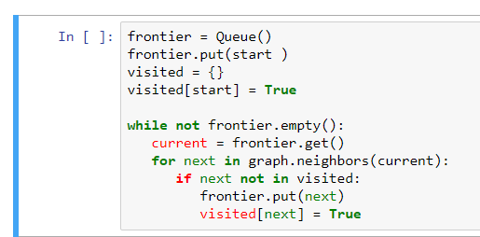
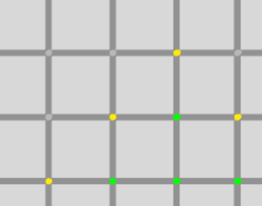
Breadth Based Search - Flood Fill
frontier: FIFO queue
visited: dictionary of node status
graph: contains information for nodes
neighbors: returns adjacent nodes for
given node
Source: Amit Patel
Takes a node from the queue, marks it as visited and places neighboring nodes into the queue
Iterates through graph until every node has been visited
To take a graph and return paths between nodes, another step is needed
Frontier
Visited

Slide 4
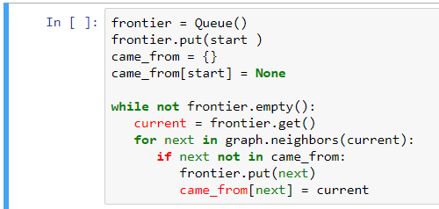
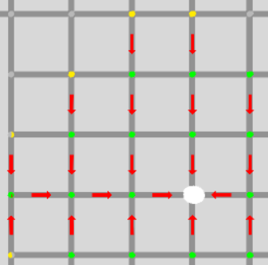
Breadth Based Search – Bread Crumbs
came_from: dictionary of node status
graph: contains information for nodes
neighbors: returns adjacent nodes for
given node
Source: Amit Patel
To get a path back to the starting node, instead of marking nodes as visited it is passed to the next node in the frontier as a reference
Every new node that is added to the frontier knows which node it came
from, back to the starting node

Slide 5
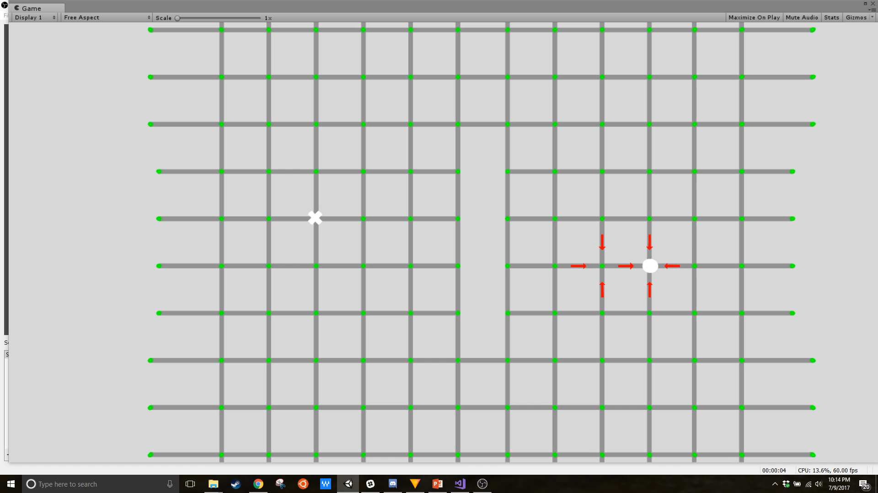
Breadth Based Search – Bread Crumbs
Red arrows link two adjacent nodes together
As nodes are added to the frontier a path is generated that always leads back to the starting node

Slide 6
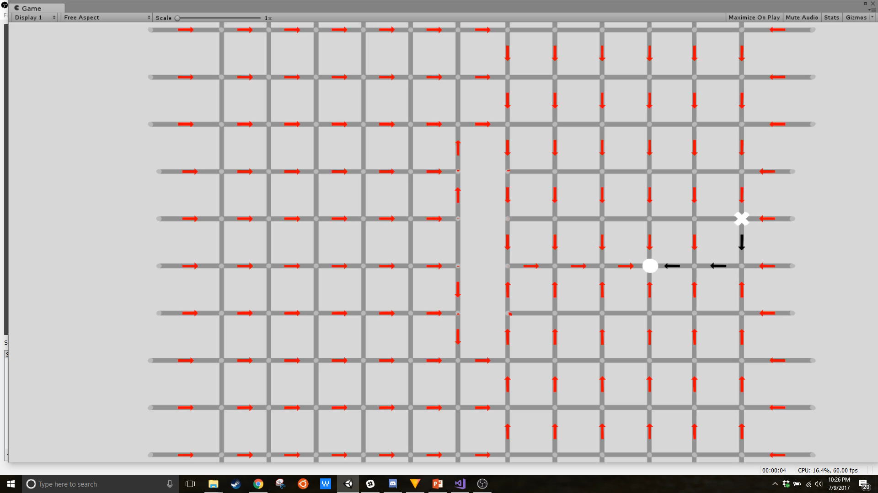
Breadth Based Search – Bread Crumbs
For each node on the graph, the “bread crumbs” can be reversed and returned as a list to provide a node by node set of instructions to reach the node from the starting node

Slide 7
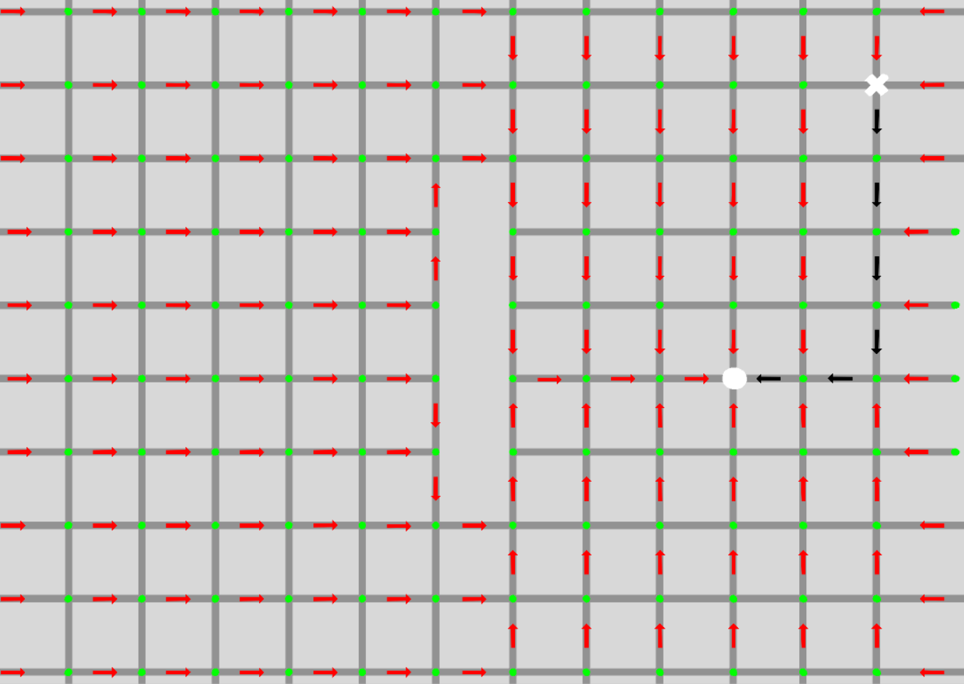
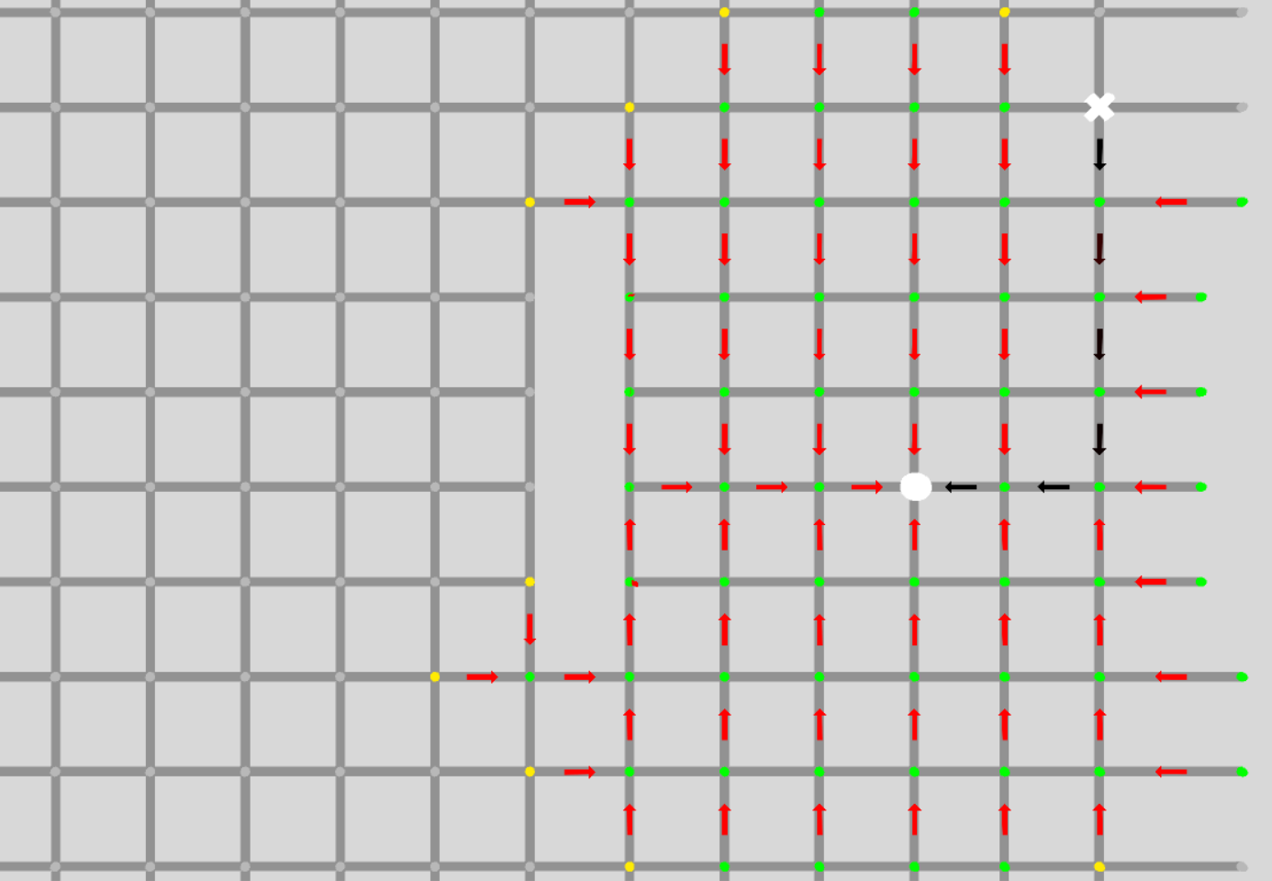
Early Exit
A path finding algorithm can be evaluated through the entire graph and return a path for ever node, or it can be evaluated lazily, meaning the algorithm terminates once the shortest path to the goal node is found. Early exit can optimize the algorithm when it is being used to find the path to a single node as opposed to every node in the graph.
Without early exit, the algorithm checks every node
With early exit, the algorithm exits once the goal is found

Slide 8
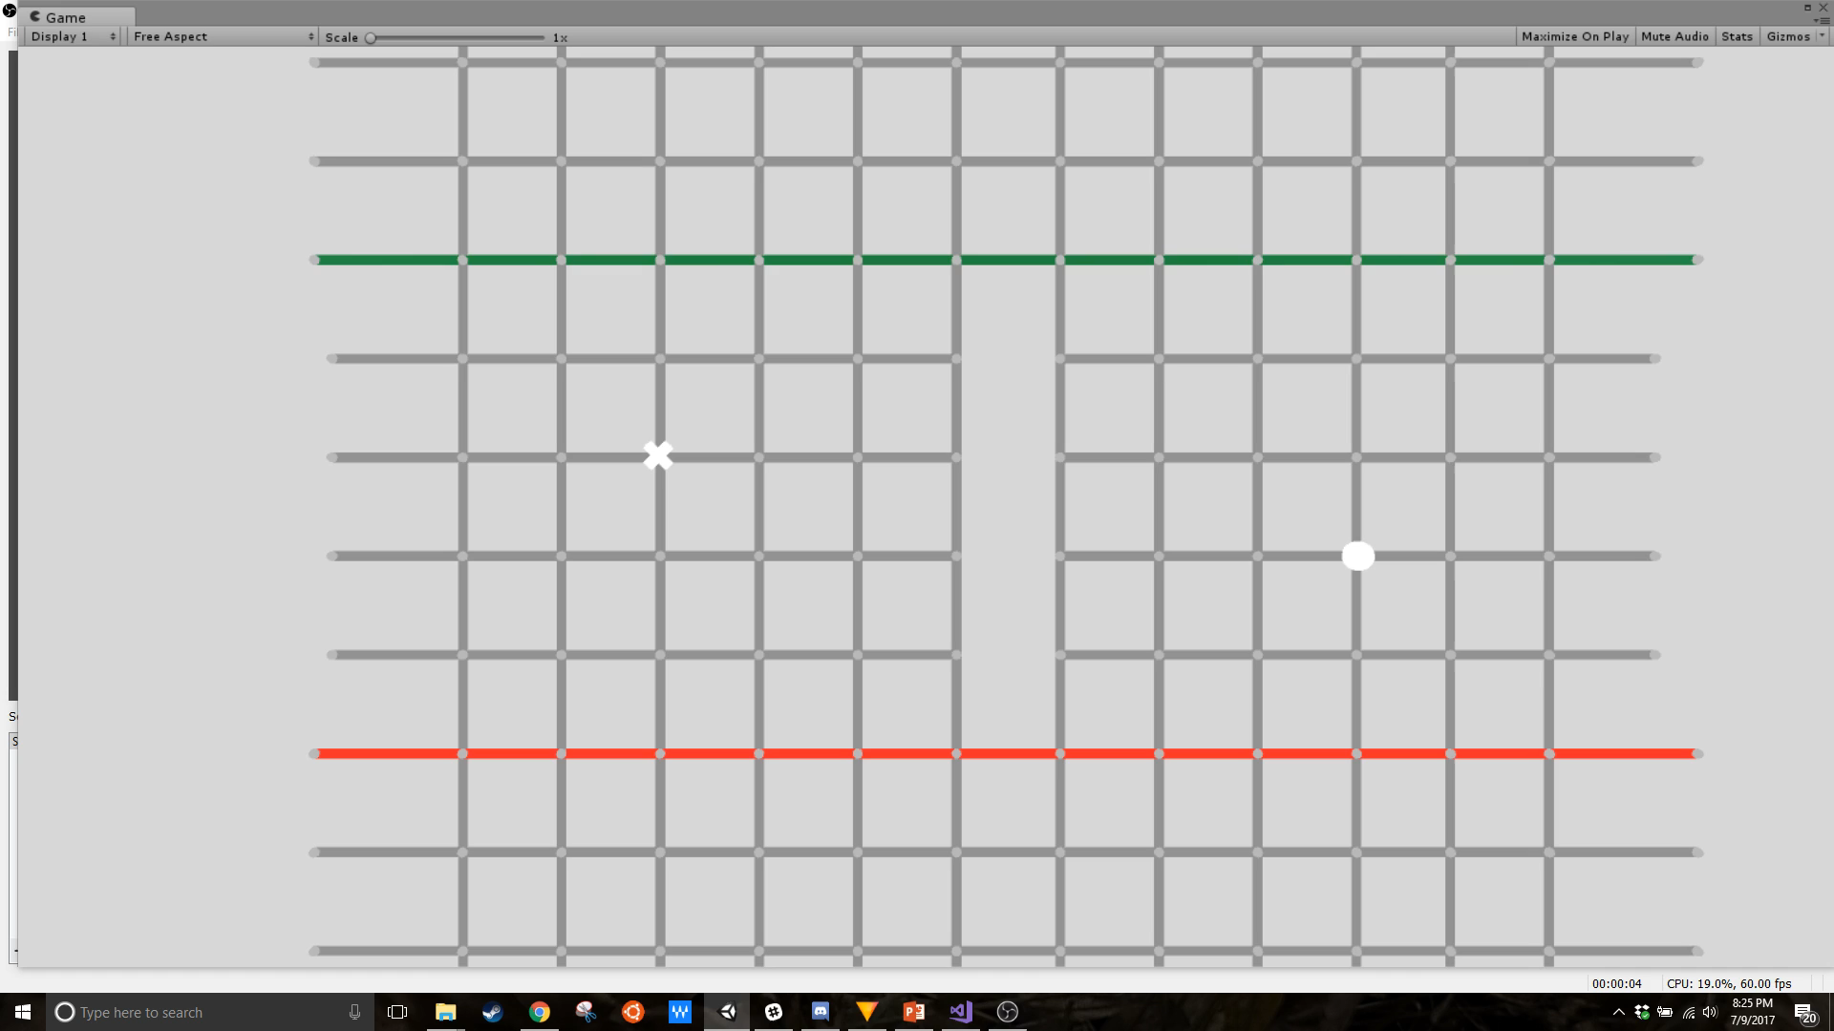
Uniform Cost Search - Dijkstra’s Algorithm
Not every graph has nodes with identical properties
Graphs with varying traversal costs, such as a graph of a road system, require the algorithm to account for movement costs between nodes
Instead of a FIFO queue, Dijkstra’s Algorithm organizes the frontier according to a priority queue

Slide 9
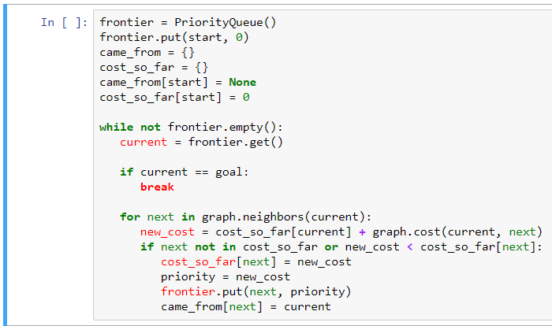
Uniform Cost Search - Dijkstra’s Algorithm
frontier: priority queue where lower cost nodes
are retrieved first
cost_so_far: returns the movement cost between
a given goal and the starting node
new_cost: finds the cost_so_far of the next node by
adding the cost_so_far of the current to
the marginal cost of the next
Source: Amit Patel
Dijkstra’s Algorithm adds to the Breadth First method by prioritizing the order in which to visit neighbor nodes according to the movement cost associated with each node
Allows the algorithm to take into account complications such as traffic or rough terrain

Slide 10
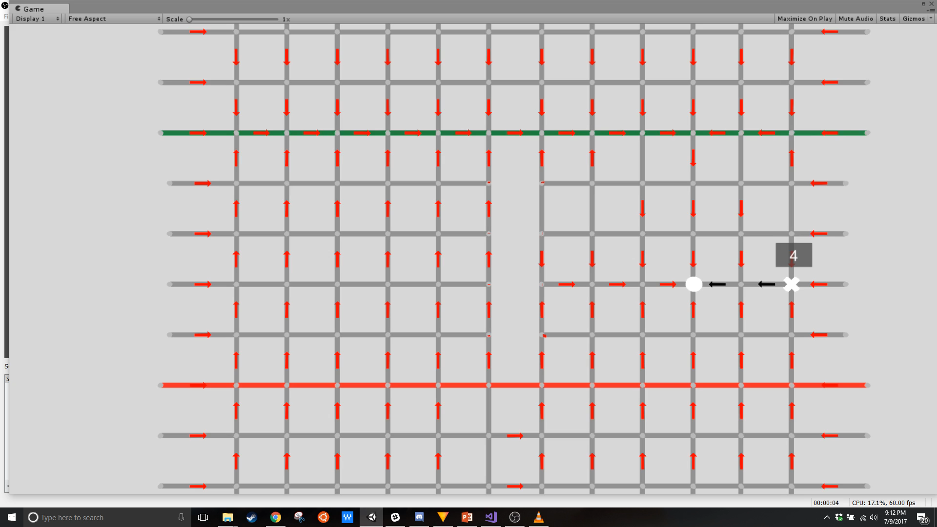
Uniform Cost Search - Dijkstra’s Algorithm
Nodes on green line cost 0, nodes on red line cost 5, others 2
Dijkstra’s Algorithm is able to recognize that the green line is much preferable to red, and routes paths through the green line wherever possible while avoiding red

Slide 11
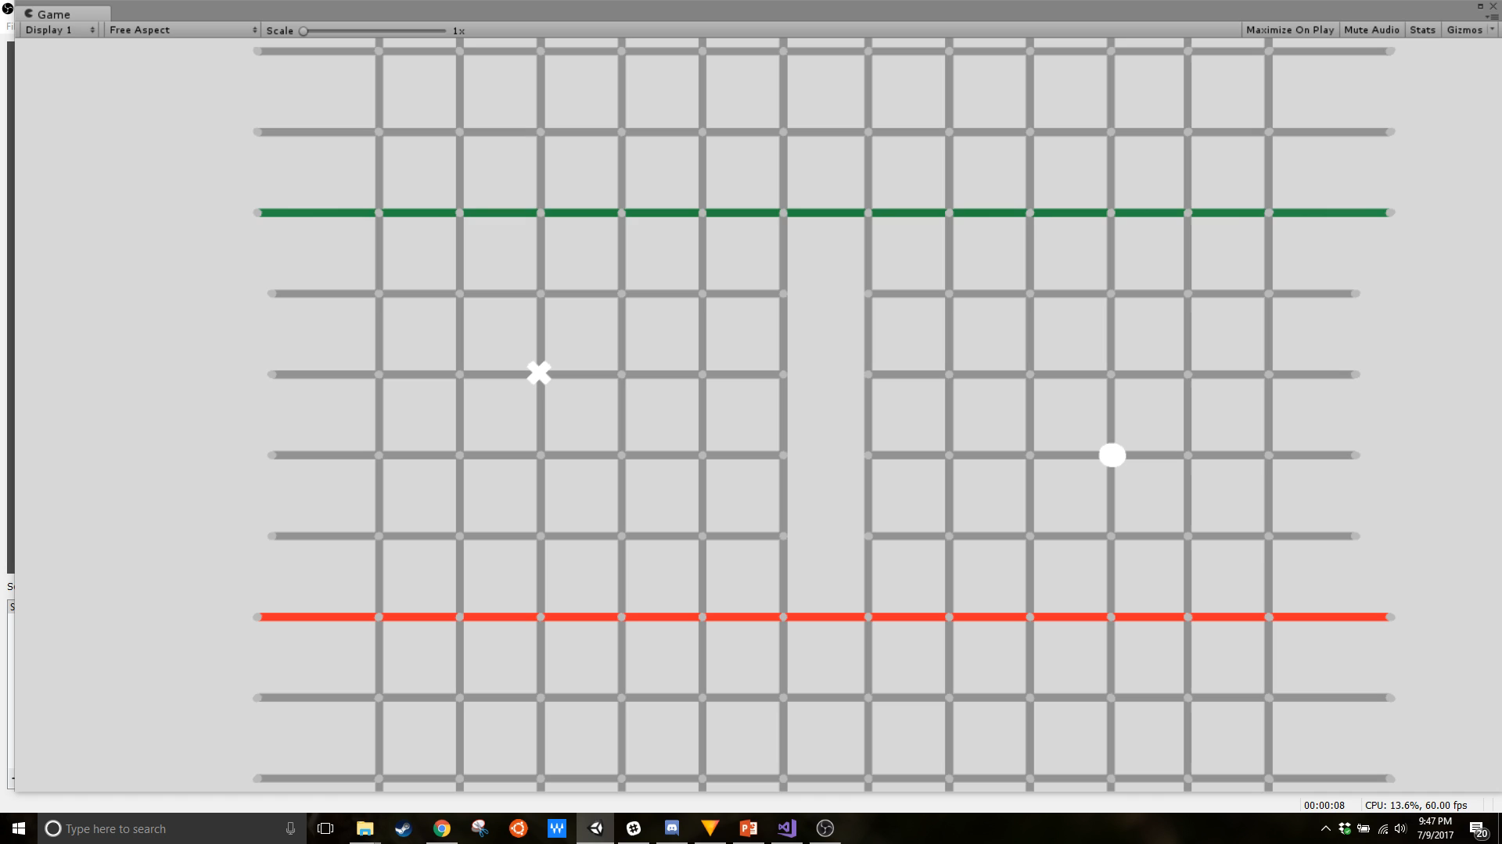
Cost Search + Heuristic – A* Algorithm
A* takes Dijkstra’s Algorithm and optimizes it to find the path to a single node as efficiently as possible
A* takes the estimated distance between the start and goal node and prioritizes low cost nodes that are closer to the goal

Slide 12
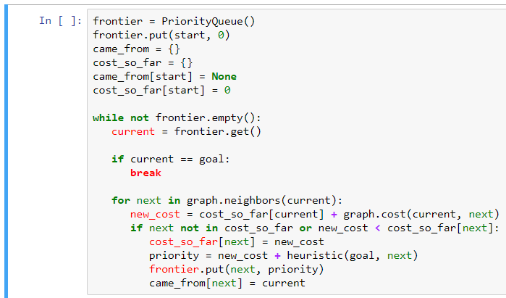
Cost Search + Heuristic – A* Algorithm
heuristic: estimates the distance between each
neighbor node and the goal node and
decreases the priority of farther away nodes
Source: Amit Patel
A* will try to only visit nodes that are closer to the goal than the current node, minimizing the resources used to complete the algorithm
Sets node priority by combining the cost method of Dijkstra’s Algorithm with the distance heuristic.

Slide 13

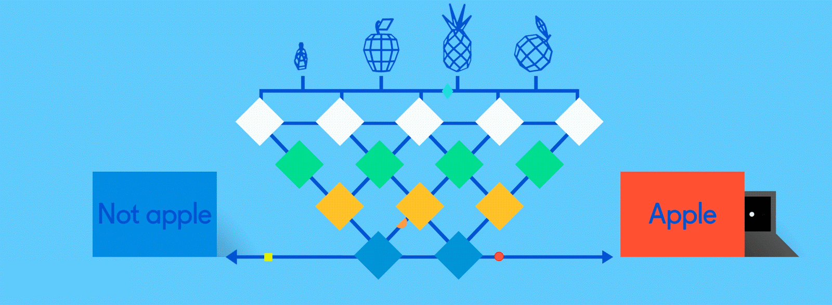
Applications to Data Science
Many problems in Data Science can be represented as Probabilistic Graphical Modules (PGMs), which can be operated on by graph search algorithms
Collaborative filtering techniques used in recommender systems analyze relational data points that can be represented graphically
Neural networks are an interconnected set of nodes that can be compared to the network of neurons in a brain. Connections between nodes can be traversed using graph search algorithms
Source: my Amazon homepage
Source: Techcrunch

